Slide 1
CSE1142 – Arrays in C
Adapted from Dr. Sanem Arslan Yılmaz.
Some of the slides are from: CMPE150 – Boğaziçi University, Deitel & Associates.

Slide 2
Agenda
Arrays
  Definitions & Syntax
  Initialization
  Index and bounds
Size of Arrays
Examples
Passing Arrays to Functions
Sorting Arrays
Searching Arrays
Multidimensional Arrays

Slide 3
Motivation
You may need to define many variables of the same type.
  Defining so many variables one by one is cumbersome.
Probably you would like to execute similar statements on these variables.
  You would not want to write the same statements over and over for each variable.

Slide 4
Arrays – Definitions & Syntax
An array is a variable that is a collection of multiple values of the same type.
Syntax:
    type array_name[int_constant_value]={initializer_list};
The size has to be of int type and must be a fixed value (i.e., known at compile time).
  Static entity – same size throughout program
You can define an array of any type (e.g.: int, float, enum student_type, etc.)
All elements of the array have the same type.

Slide 5
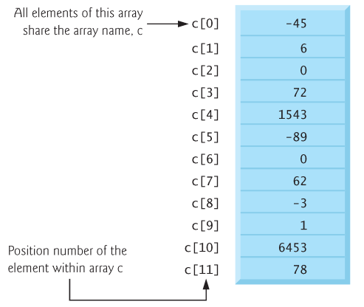
Arrays - Usage
Array
  Group of consecutive memory locations
  Same name and type
To refer to an element, specify
  Array name
  Position number
Format:
    arrayname[position number ]
  First element at position 0
  n element array named c:
    c[0], c[1], ..., c[n–1]

Slide 6
Array - Access
Array elements are like normal variables
    c[ 0 ] = 3;
    printf( "%d", c[ 0 ] );
Perform operations in subscript (or index). If x equals 3
    c[ 5 - 2 ] == c[ 3 ] == c[ x ]

Slide 7
Defining Arrays
When defining arrays, specify
  Name
  Type of array
  Number of elements
    arrayType arrayName[ numberOfElements ];
  Examples:
    int c[ 10 ];
    float myArray[ 3284 ];
Defining multiple arrays of same type
  Format similar to regular variables
  Example:
    int b[ 100 ], x[ 27 ];

Slide 8
Arrays – Initialization
The elements of a local array are initialized arbitrary (as all other local variables).
The elements of a global array are initialized to zero by default (as all other global variables).
You may initialize an array during definition as follows:
    int array[5] = {10, 8, 36, 9, 13};
However, you cannot perform such an initialization after the definition, i.e.,
    int array[5];
    array = {10, 8, 36, 9, 13};
  is syntactically wrong.

Slide 9
Arrays – Initialization Example
Initializers
    int n[ 5 ] = { 1, 2, 3, 4, 5 };
  If there are fewer initializers than elements in the array, the remaining elements are initialized to zero.
      int n[ 5 ] = { 0 }
    All elements 0
  If there are more initializers than the size of the array, a syntax error is produced.
If the array size is omitted from a definition with an initializer list, the number of elements in the array will be the number of elements in the initializer list.
    int n[ ] = { 1, 2, 3, 4, 5 };
  5 initializers, therefore 5 element array

Slide 10
Arrays – Index and bounds
The index must be of int type.
int k[5];
k[k[4]/k[1]]=2;
k[1.5] = 3; /* Error since 1.5 is not int */
C has no array bounds checking to prevent the program from referring to an element that does not exist.
  Thus, an executing program can “walk off” either end of an array without warning
  You should ensure that all array references remain within the bounds of the array.

Slide 11
Arrays Have Fixed Size!
The size of an array must be stated at compile time.
This means you cannot define the size when you run the program. You should fix it while writing the program.
This is a very serious limitation for arrays. Arrays are not fit for dynamic programming.
  You should use pointers for this purpose.
Examples:
  Initialize_zero.c
  Initialize_value.c

Slide 12
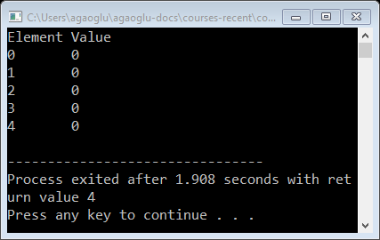
  Example 1: Initialize_zero.c
// Initializing the elements of an array to zeros.
#include <stdio.h>
// function main begins program execution
int main(void)
{
int n[5], i; // n is an array of five integers
// set elements of array n to 0
for (i = 0; i < 5; ++i) {
n[i] = 0; // set element at location i to 0
}
printf("%s\t%s\n", "Element", "Value");
// output contents of array n in tabular format
for (i = 0; i < 5; ++i) {
printf("%d\t%d\n", i, n[i]);
}
}

Slide 13
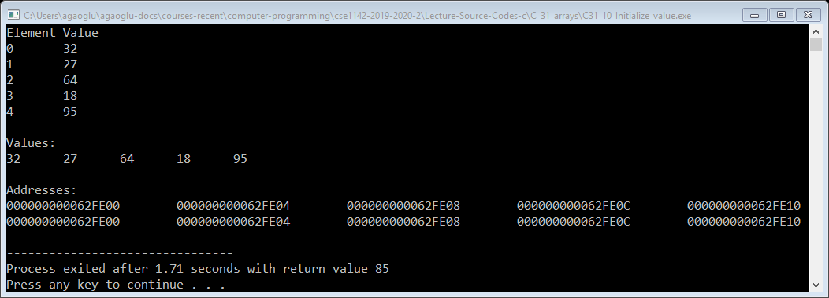
  Example 2: Initialize_value.c
// Initializing the elements of an array with an initializer list.
#include <stdio.h>
// function main begins program execution
int main(void)
{
// use initializer list to initialize array n
int x;
int i, n[5] = {32, 27, 64, 18, 95};
printf("%s\t%s\n", "Element", "Value");
// output contents of array in tabular format
for (i = 0; i < 5; ++i) {
printf("%d\t%d\n", i, n[i]);
}
printf("\nValues:\n");
printf("%d\t%d\t%d\t%d\t%d\n", *n, *(n+1),*(n+2),*(n+3),*(n+4));
printf("\nAddresses:\n");
printf("%p\t%p\t%p\t%p\t%p\n", n, n+1, n+2, n+3, n+4);
printf("%p\t%p\t%p\t%p\t%p\n", &n[0], &n[1], &n[2], &n[3], &n[4]);
}

Slide 14
  Output of Initialize_value.c

Slide 15
Arrays Have Fixed Size!
What you can do is to define very large arrays, making the size practically infinite → Wastes too much memory.
Your program may exceed the maximum memory limit for the process.

Slide 16
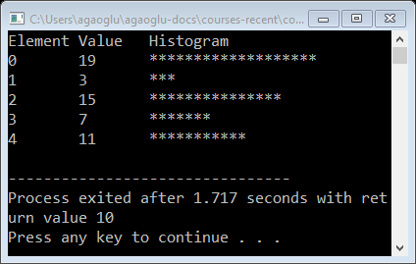
Example 3: Histogram
// Displaying a histogram.
#include <stdio.h>
#define SIZE 5
int main(void){
// use initializer list to initialize array n
int i, j, n[SIZE] = {19, 3, 15, 7, 11};
printf("%s\t%s\t%s\n", "Element", "Value", "Histogram");
// for each element of array n, output a bar of the histogram
for (i = 0; i < SIZE; ++i) {
printf("%d\t%d\t", i, n[i]) ;
for (j = 1; j <= n[i]; ++j) { // print one bar
printf("%c", '*');
}
printf("\n"); // end a histogram bar with a newline
}
}

Slide 17
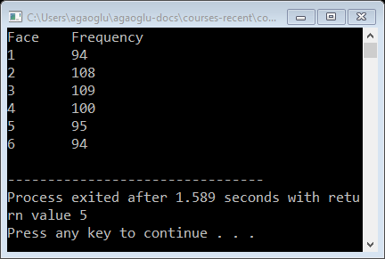
Example 4: Roll dice
#include <stdio.h>
#include <stdlib.h>
#include <time.h>
#define SIZE 7
int main(void){
unsigned int frequency[SIZE] = {0}; // clear counts
unsigned int roll, face;
srand(time(NULL)); // seed random number generator
// roll die 600 times
for (roll = 1; roll <= 600; ++roll) {
face = 1 + rand() % 6;
++frequency[face];
}
printf("%s\t%s\n", "Face", "Frequency");
// output frequency elements 1-6 in tabular format
for (face = 1; face < SIZE; ++face) {
printf("%d\t%d\n", face, frequency[face]);
}
}

Slide 18
Arrays as Parameters
Although you write like a value parameter,
  an array is always passed by reference (variable parameter).
  Therefore, when you make a change in an element of an array in the function, the change is visible from the caller.

Slide 19
Passing Arrays to Functions
Passing arrays
  To pass an array argument to a function, specify the name of the array without any brackets
      int myArray[ 24 ];
      myFunction( myArray, 24 );
    Array size usually passed to function
  Arrays passed call-by-reference
  The name of array is address of first element
  Function knows where the array is stored
    Modifies original memory locations
Passing array elements
  Passed call-by-value
  Pass subscripted name (i.e., myArray[ 3 ]) to function

Slide 20
Passing Arrays to Functions – cont.
Function prototype
    void modifyArray( int b[], int arraySize );
  Parameter names optional in prototype
    int b[] could be written as int []
    int arraySize could be simply int
Examples:
  Initialize_function.c
  Initialize_function2.c
  Initialize_function_size.c
  Modify_array.c

Slide 21
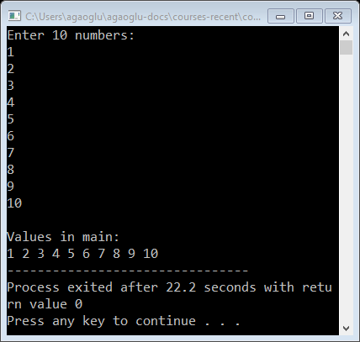
Example 5 – Initialize_function.c
Fill in an array of integer from input.
  #include <stdio.h>
  void read_array(int ar[10])
  { int i;
  for (i=0; i<10; i++)
  scanf("%d", &ar[i]);
  }
  int main()
  { int a[10], i;
  read_array(a);
  for (i=0; i<10; i++)
  printf("%d ", a[i]);
  return 0;
  }
Notes:
After this; run the followings:
- Initialize_function2.c
- Initialize_function_size.c

Slide 22
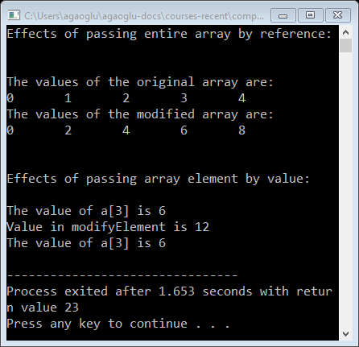
Example 6 – Modify_array.c
// in function modifyArray, "b" points to the
// original array "a" in memory
void modifyArray(int b[], int size){
int j;
// multiply each array element by 2
for (j = 0; j < size; ++j) {
b[j] *= 2; // actually modifies original array
}
}
// in function modifyElement, "e" is a local copy of
// array element a[3] passed from main
void modifyElement(int e){
// multiply parameter by 2
printf("Value in modifyElement is %d\n", e *= 2);
}
// Passing arrays and individual array elements to functions.
#include <stdio.h>
#define SIZE 5
void modifyArray(int b[], int size);
void modifyElement(int e);
int main(void){
int a[SIZE] = { 0, 1, 2, 3, 4 }; // initialize array a
int i;
printf("Effects of passing entire array by reference:\n\nThe "
"values of the original array are:\n");
for (i = 0; i < SIZE; ++i) {
printf("%d\t", a[i]);
}
printf("\n");
modifyArray(a, SIZE); // pass array a to modifyArray by reference
printf(“\nThe values of the modified array are:\n");
for (i = 0; i < SIZE; ++i) {
printf("%d\t", a[i]);
}
printf("\n\n\nEffects of passing array element "
"by value:\n\nThe value of a[3] is %d\n", a[3]);
modifyElement(a[3]); // pass array element a[3] by value
printf("The value of a[3] is %d\n", a[3]);
}

Slide 23
Sorting Arrays – Bubble Sort
Sorting data
  Important computing application
  Virtually every organization must sort some data
Bubble sort (sinking sort)
  Several passes through the array
  Successive pairs of elements are compared
    If increasing order (or identical ), no change
    If decreasing order, elements exchanged
  Repeat
Example:
  original: 3 4 2 6 7
  pass 1: 3 2 4 6 7
  pass 2: 2 3 4 6 7
  Small elements "bubble" to the top
Notes:
Watch the video:
https://www.youtube.com/watch?v=nmhjrI-aW5o

Slide 24
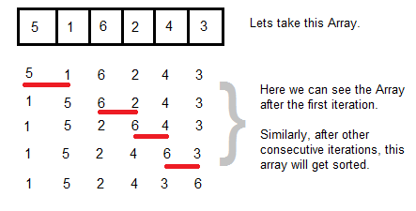
Bubble Sort

Slide 25
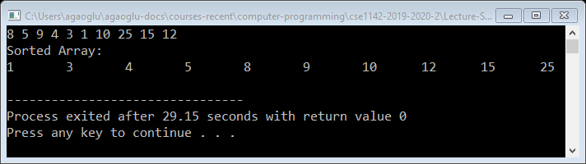
Example – Bubble Sort
  void read_array(int ar[], int size)
  { int i;
  for (i=0; i<size; i++)
  scanf("%d", &ar[i]);
  }
  void print_array(int ar[], int size)
  { int i;
  printf("Sorted Array:\n");
  for (i=0; i<size; i++)
  printf("%d\t", ar[i]);
  printf("\n");
  }
  void swap(int *a, int *b)
  { int temp;
  temp = *a;
  *a = *b;
  *b = temp;
  }
void bubble_sort(int ar[], int size)
{ int i, j;
for (i = 0; i < size-1; i++)
for (j = 0; j < size-1-i; j++)
if (ar[j] > ar[j+1])
swap(&ar[j],&ar[j+1]);
}
int main()
{ int ar[10];
read_array(ar,10);
bubble_sort(ar,10);
print_array(ar,10);
return 0;
}
Notes:
- Run C31_50_Bubble_sort.c.

Slide 26
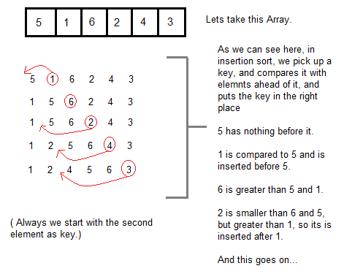
Insertion Sort
Notes:
Watch the video:
https://www.youtube.com/watch?v=OGzPmgsI-pQ

Slide 27
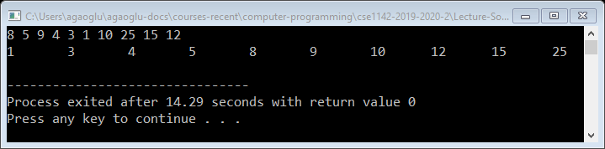
Example – Insertion Sort
  void insertion_sort(int ar[], int size)
  {
  int value, i, j;
  for (i=1; i<size; i++)
  {
  value = ar[i];
  j = i-1;
  while ((j>=0) && (ar[j]>value))
  {
  ar[j+1] = ar[j];
  j--;
  }
  ar[j+1] = value;
  }
  }
Notes:
Run C31_55_Insertion_sort.c.

Slide 28
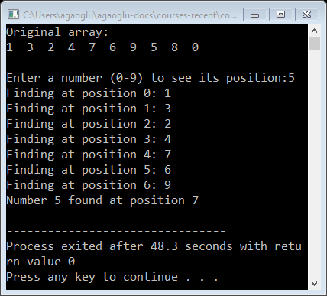
Searching Arrays
Search an array for a key value
Linear search
  Simple
  Compare each element of array with key value
  Useful for small and unsorted arrays
Binary search
  For sorted arrays
  Compares middle element with key
    If equal, match found
    If key < middle, looks in first half of array
    If key > middle, looks in last half
    Repeat
Notes:
Watch linear search: https://www.youtube.com/watch?v=PDE8pCQ9Tz4
Watch binary search: https://www.youtube.com/watch?v=sr_bR1WwcLY
Run C31_60_findNumber.c

Slide 29
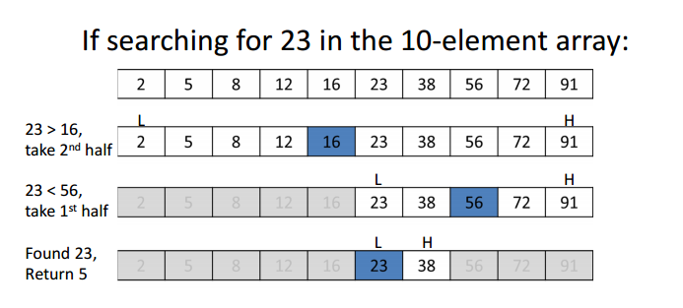
Binary Search

Slide 30
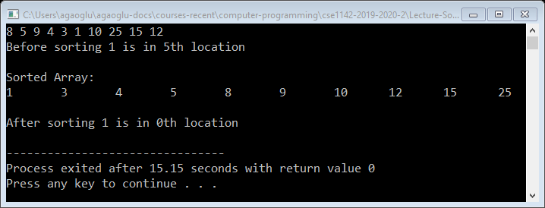
Example – Binary Search
  int binary_search(int A[], int number, int N)
  {
  int low = 0, high = N - 1, mid;
  while (low <= high)
  {
  mid = (low + high) / 2;
  if (A[mid] == number)
  return mid;
  if (A[mid] < number)
  low = mid + 1;
  else
  high = mid - 1;
  }
  return -1;
  }
Notes:
- Run C31_65_Binary_search.c.

Slide 31
Multidimensional Arrays
Multiple subscripted arrays
  Tables with rows and columns (m by n array)
  Like matrices: specify row, then column
Column 0
Column 1
Column 2
Column 3
Row 0
a[ 0 ][ 0 ]
a[ 0 ][ 1 ]
a[ 0 ][ 2 ]
a[ 0 ][ 3 ]
Row 1
a[ 1 ][ 0 ]
a[ 1 ][ 1 ]
a[ 1 ][ 2 ]
a[ 1 ][ 3 ]
Row 2
a[ 2 ][ 0 ]
a[ 2 ][ 1 ]
a[ 2 ][ 2 ]
a[ 2 ][ 3 ]
Column subscript
Array name
Row subscript

Slide 32
Multidimensional Arrays – Initialization & Accessing Elements
Initialization
  int b[ 2 ][ 2 ] = { { 1, 2 }, { 3, 4 } };
  Initializers grouped by row in braces
  If not enough, unspecified elements set to zero
    int b[ 2 ][ 2 ] = { { 1 }, { 3, 4 } };
Referencing elements
  Specify row, then column
    printf( "%d", b[ 0 ][ 1 ] );
1 2
3 4
1 0
3 4

